Slide 1

VOLTORB – JULY IR remote, motor, LED

Slide 2
Problem statement
Mr. Mad-eye is very moody. He's particular about the lighting and ventilation in his house.
He has 4-5 light bulbs and at least 1 fan. He uses a remote to control them.
He should be able to increase or decrease the speed of the fan using the remote.
Whatever number he presses on the remote, those many light bulbs should turn on.
The speed of the fan should increase or decrease in accordance with the number of bulbs.
Instructions:
• Usage of microcontroller is allowed.

Slide 3
Hints:
Use an IR remote.
Use a microcontroller to write the LEDs high according to the number pressed on the remote.
Change the motor speed accordingly.

Slide 4
How to solve?
We gather our components first, rig the circuit, code the microcontroller and hope Mr. Mad-eye is happy.

Slide 5
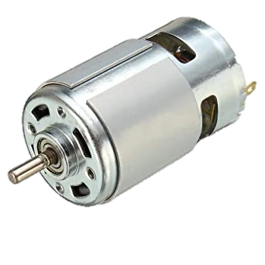

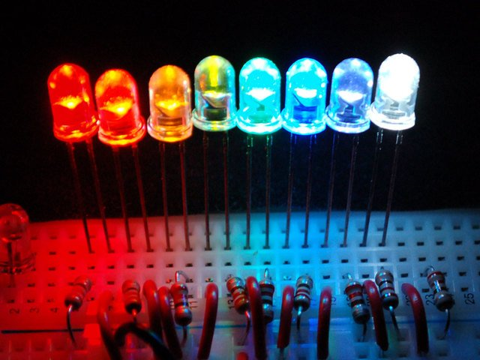
Gang members
IR Remote
LED
DC Motor

Slide 6
Method
IR Remote
The configuration of IR remote is not as easy as the other components here. Receive input from the IR remote via an IR sensor, and use that input to write output to the LEDs.
LED
Write those many LEDs high when a particular number is pressed on the IR remote.
DC motor
This is the simplest part yet. Choose a particular value of speed for each number pressed, and then write that value to the motor, and you’re set.

Slide 7

IR Remote
Make sure to decode the signals from the IR Remote. Then allocate a specific function for each input. In this case, input from pressing ‘3’ on the remote should lead to 3 LED lighting up.

Slide 8
Libraries
IRremote.h
Once you make sure your connection is right, include the IR library in your code. Specify the functionality of LED and DC motor.

Slide 9
It is now done.
Add extra functionality, make the led follow a pattern here or add a piezo there, make it fancy!

Slide 10
Didn’t we say Mr. Mad-eye is moody?

Slide 11
Resources
Check out these links for reference.
https://create.arduino.cc/projecthub/electropeak/use-an-ir-remote-transmitter-and-receiver-with-arduino-1e6bc8
https://www.circuitbasics.com/arduino-ir-remote-receiver-tutorial/
https://randomnerdtutorials.com/arduino-ir-remote-control/

Slide 12
Thanks!
Any questions?
Feel free to discuss any related topics in the WhatsApp group!
-IEEE UVCE PES

